Slide 1
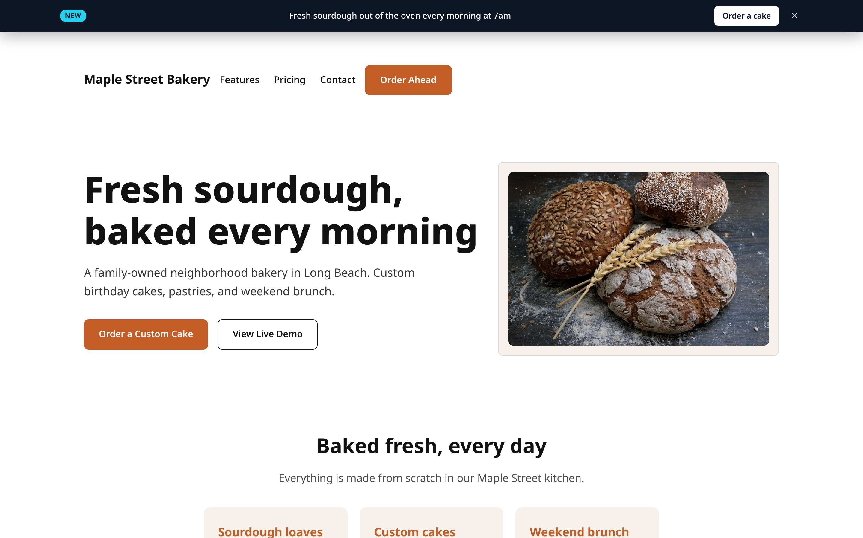
CLIENT HOW-TO · REGISTERMYSITE
sites.registermysite.com/maple-street-bakery-demo/
Build & publish
your page
with HTML Studio
Account, sections, widgets, analytics, schema, and going live, step by step.
The demo page we’ll build today, live on the web
Ryan Swanson · RegisterMySite.com
Notes:
Hi everyone, I'm Ryan Swanson with RegisterMySite. Today I'm going to show you HTML Studio, our browser-based page builder.
By the end you'll know how to create your account, build a page from a template, add a widget, turn on analytics, add the behind-the-scenes code that helps Google understand your business, and publish it live.
And this isn't a mock-up. Everything you'll see is a real page I built and published while making this deck, for a made-up business called Maple Street Bakery in Long Beach. That's it on the right, live on the web.

Slide 2





WHAT IS HTML STUDIO?
A page builder that gives you a real, fast web page
Edit with forms
AI copilot
Built-in add-ons
Publish in a click
Form Mode lets you change text, links, images & colors. No code needed.
Describe a change in plain English and click “Apply AI edit.”
Widgets, EdgeTrack analytics, and a Schema generator for Google.
Pick a domain, pick a slug, click “Publish slug.” You’re live.
Why it matters: the output is a plain, static HTML page, so it loads fast, and you can also download it. The free plan includes 3 projects and 3 deploys.
registermysite.com
2
Notes:
So what is HTML Studio? It's a page builder that runs right in your browser at html-studio.registermysite.com.
Four things make it great for a small business.
One: you edit with simple forms. It's called Form Mode. Click a section, change the words, the links, the photo, the colors. No code.
Two: there's an AI copilot. You can type something like "make the headline friendlier" and click Apply AI edit.
Three: add-ons are built in. Widgets like an announcement bar, EdgeTrack analytics so you can see who's visiting, and a Schema generator that adds the behind-the-scenes info Google loves.
And four: publishing is one click. You pick a domain from a list, choose a short name for your page, and click Publish slug.
What you get at the end is a plain static HTML page. That means it's fast, and you can download it any time. When I checked, the free plan showed 3 projects and 3 deploys.

Slide 3
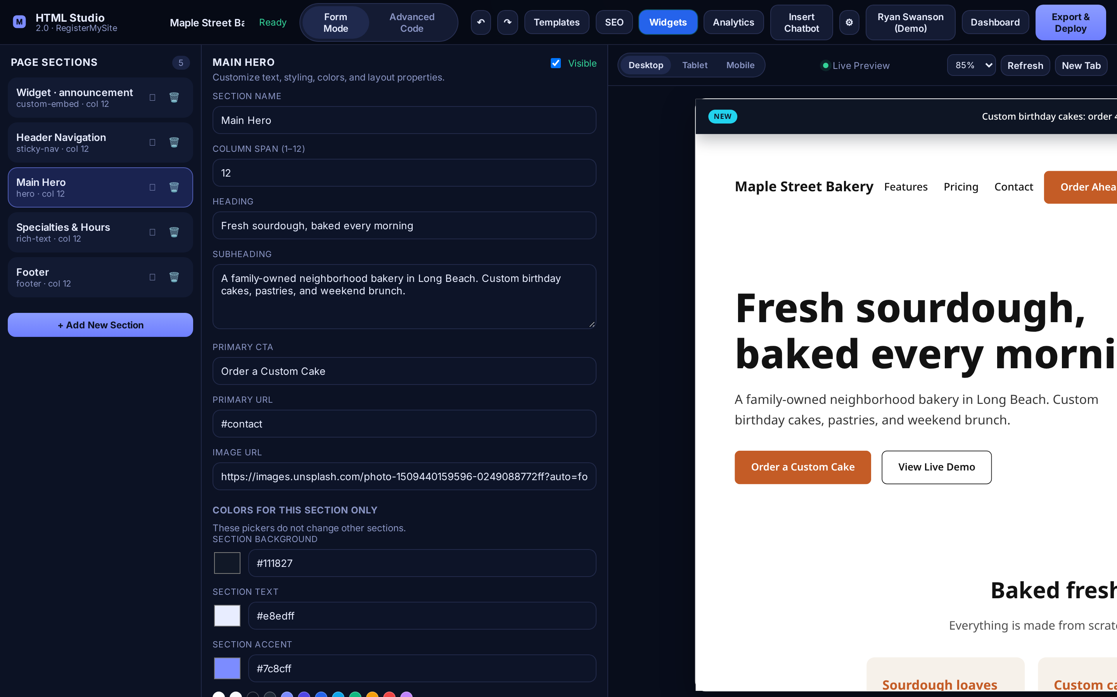
QUICK TOUR
Three panels and a top bar
4
1
Page Sections: your page, top to bottom
5
2
Section editor: fields for the selected section
1
2
3
3
Live Preview: updates as you type
4
Templates · SEO · Widgets · Analytics: the add-ons
5
Export & Deploy: publish when ready
Tip On a laptop the preview gets cut off on the right. Use “New Tab” to see the full page.
The HTML Studio editor with our demo project open. Callout 4 (pink) is the add-on group in the top bar.
registermysite.com
3
Notes:
Here's a quick tour so nothing feels unfamiliar.
On the left, number one, is Page Sections. That's your page from top to bottom: header, hero, and so on. Click any section to edit it.
In the middle, number two, is the section editor. Whatever section you clicked, its fields show up here: headline, button text, image link, colors.
On the right, number three, is the Live Preview. It updates as you type. You can switch between Desktop, Tablet, and Mobile to check how it looks on a phone.
Up top, number four, are the add-ons we'll use today: Templates, SEO, Widgets, and Analytics.
And number five, top right, is Export & Deploy. That's how you go live.
One tip: on a smaller laptop screen, the preview gets cut off on the right side. Click New Tab above the preview to see the full page.

Slide 4
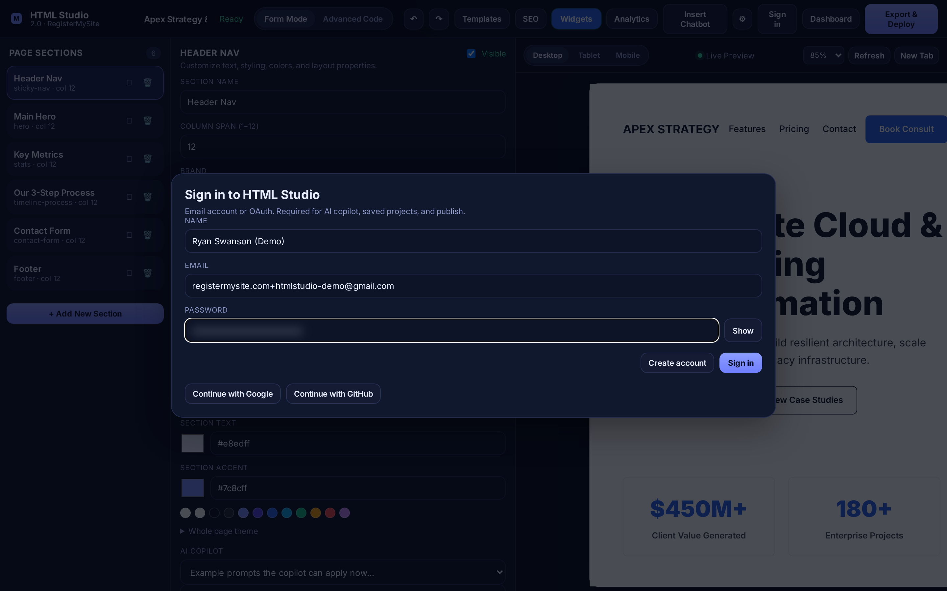
STEP 1 · CREATE YOUR ACCOUNT
Sign up in under a minute
1
Click Sign in in the top-right corner
1
2
Type your Name
3
Type your Email
2
3
4
Choose a Password (8+ characters)
4
5
5
Click Create account
Tip Prefer one click? Use “Continue with Google” or “Continue with GitHub.”
Real sign-up for our demo account. Password blurred.
registermysite.com
4
Notes:
Step one: create your account. You need one to save your work, use the AI copilot, and publish.
Go to html-studio.registermysite.com and click Sign in in the top-right corner. Don't worry that it says "Sign in"; that's also where you sign up.
A box pops up called "Sign in to HTML Studio." Type your name, your email, and pick a password with at least 8 characters. Then click Create account.
If you'd rather not make another password, you can click Continue with Google or Continue with GitHub instead.
For this demo I used a Gmail address that goes to our office inbox, and I didn't have to verify anything by email; it logged me straight in.

Slide 5
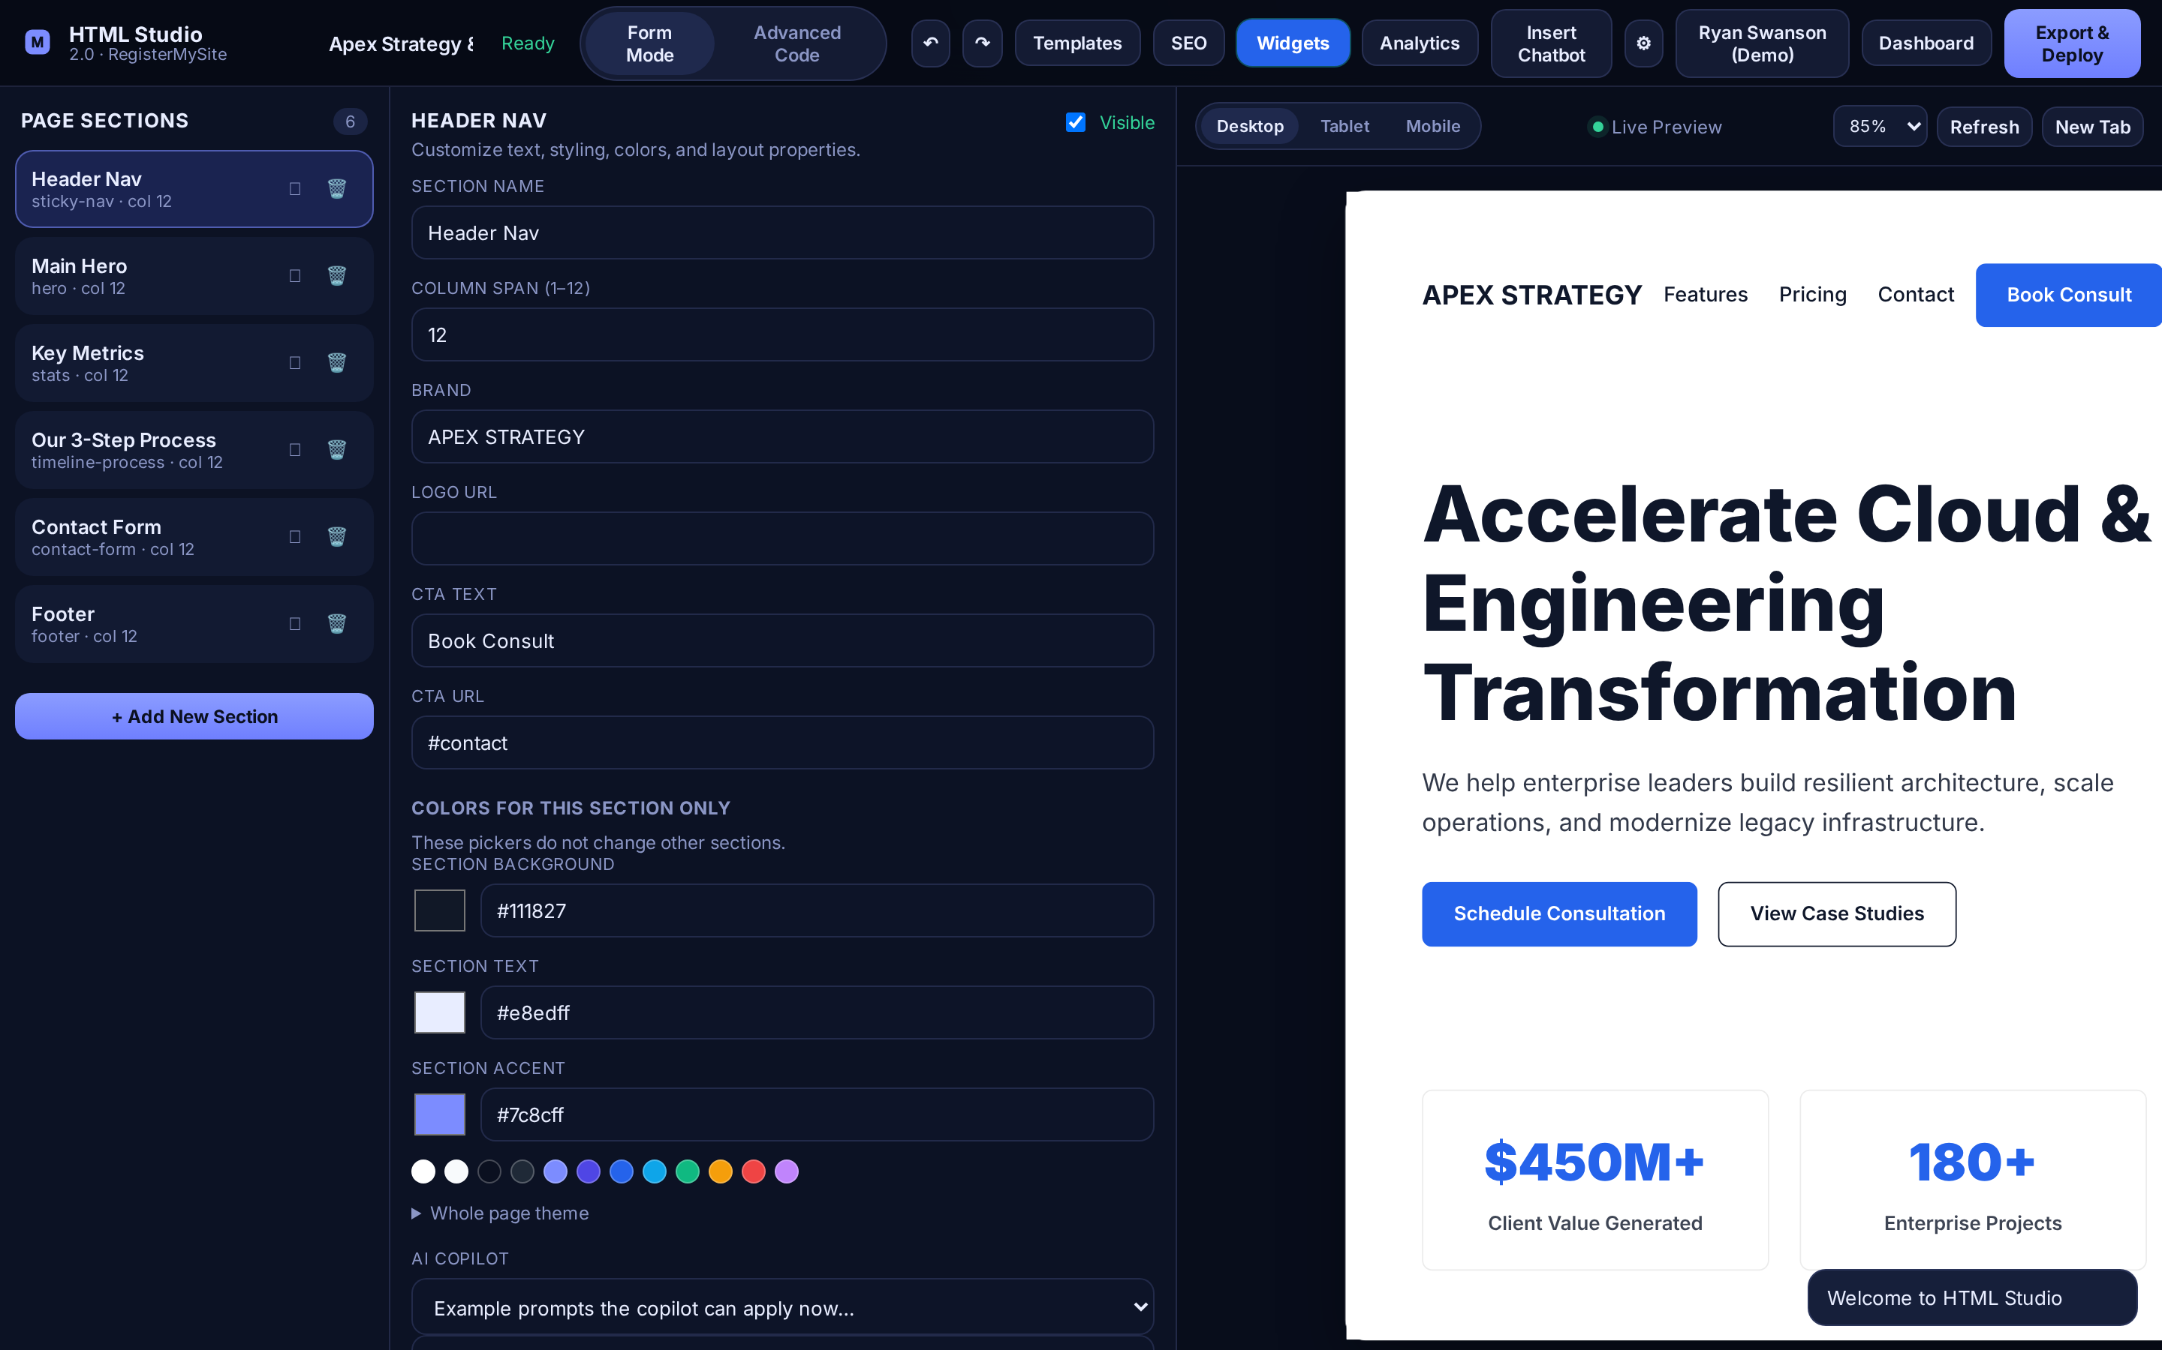

STEP 1 · CREATE YOUR ACCOUNT
You’re in! Here’s how you know
1
A “Welcome to HTML Studio” message pops up
2
2
Your name replaces the Sign in button
The ⚙ button
holds your Projects, Published sites, Photos & assets, and Saved templates.
Tip Heads-up: the page starts with a sample template. That’s normal; we’ll swap it next.
1
Right after clicking “Create account.”
registermysite.com
5
Notes:
How do you know it worked? Two things.
First, number one, a little message pops up at the bottom right: "Welcome to HTML Studio."
Second, number two, the Sign in button now shows your name.
Also good to know: the little gear button next to it is your home base. It holds your saved Projects, your Published sites, your Photos and assets, and any Saved templates.
And don't be surprised that the editor shows a sample business when you first arrive. That's just a starter template. We're going to swap it out on the next slide.

Slide 6
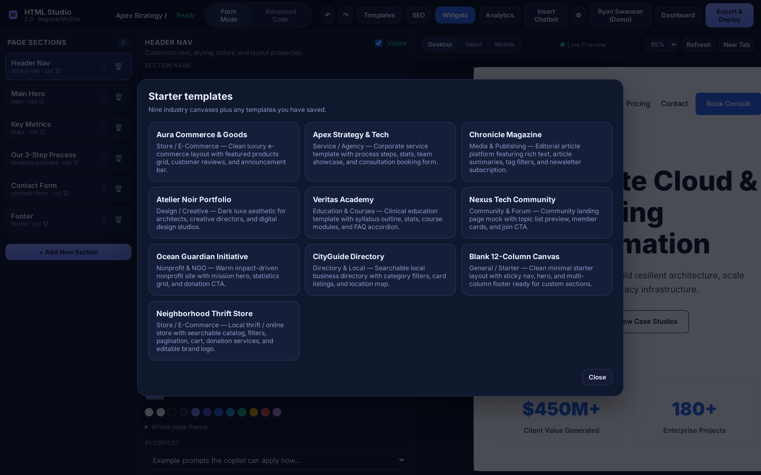
STEP 2 · PICK A STARTING POINT
Choose a template
1
Click Templates in the top bar
1
2
Pick a starter. We chose Blank 12-Column Canvas for a clean slate
There are industry starters too: e-commerce, agency, magazine, community, nonprofit, directory, and more.
2
Tip Picking a template replaces the current page, so choose it first.
The “Starter templates” window.
registermysite.com
6
Notes:
Step two: pick a starting point.
Click Templates in the top bar, number one. A window called "Starter templates" opens with a bunch of ready-made designs: online store, agency, magazine, nonprofit, directory, and more.
For our bakery I picked number two, the Blank 12-Column Canvas. It gives you a clean page with a header, a big hero section, and a footer, and you build from there.
One tip: choosing a template replaces what's on the page, so do this first, before you start editing.

Slide 7
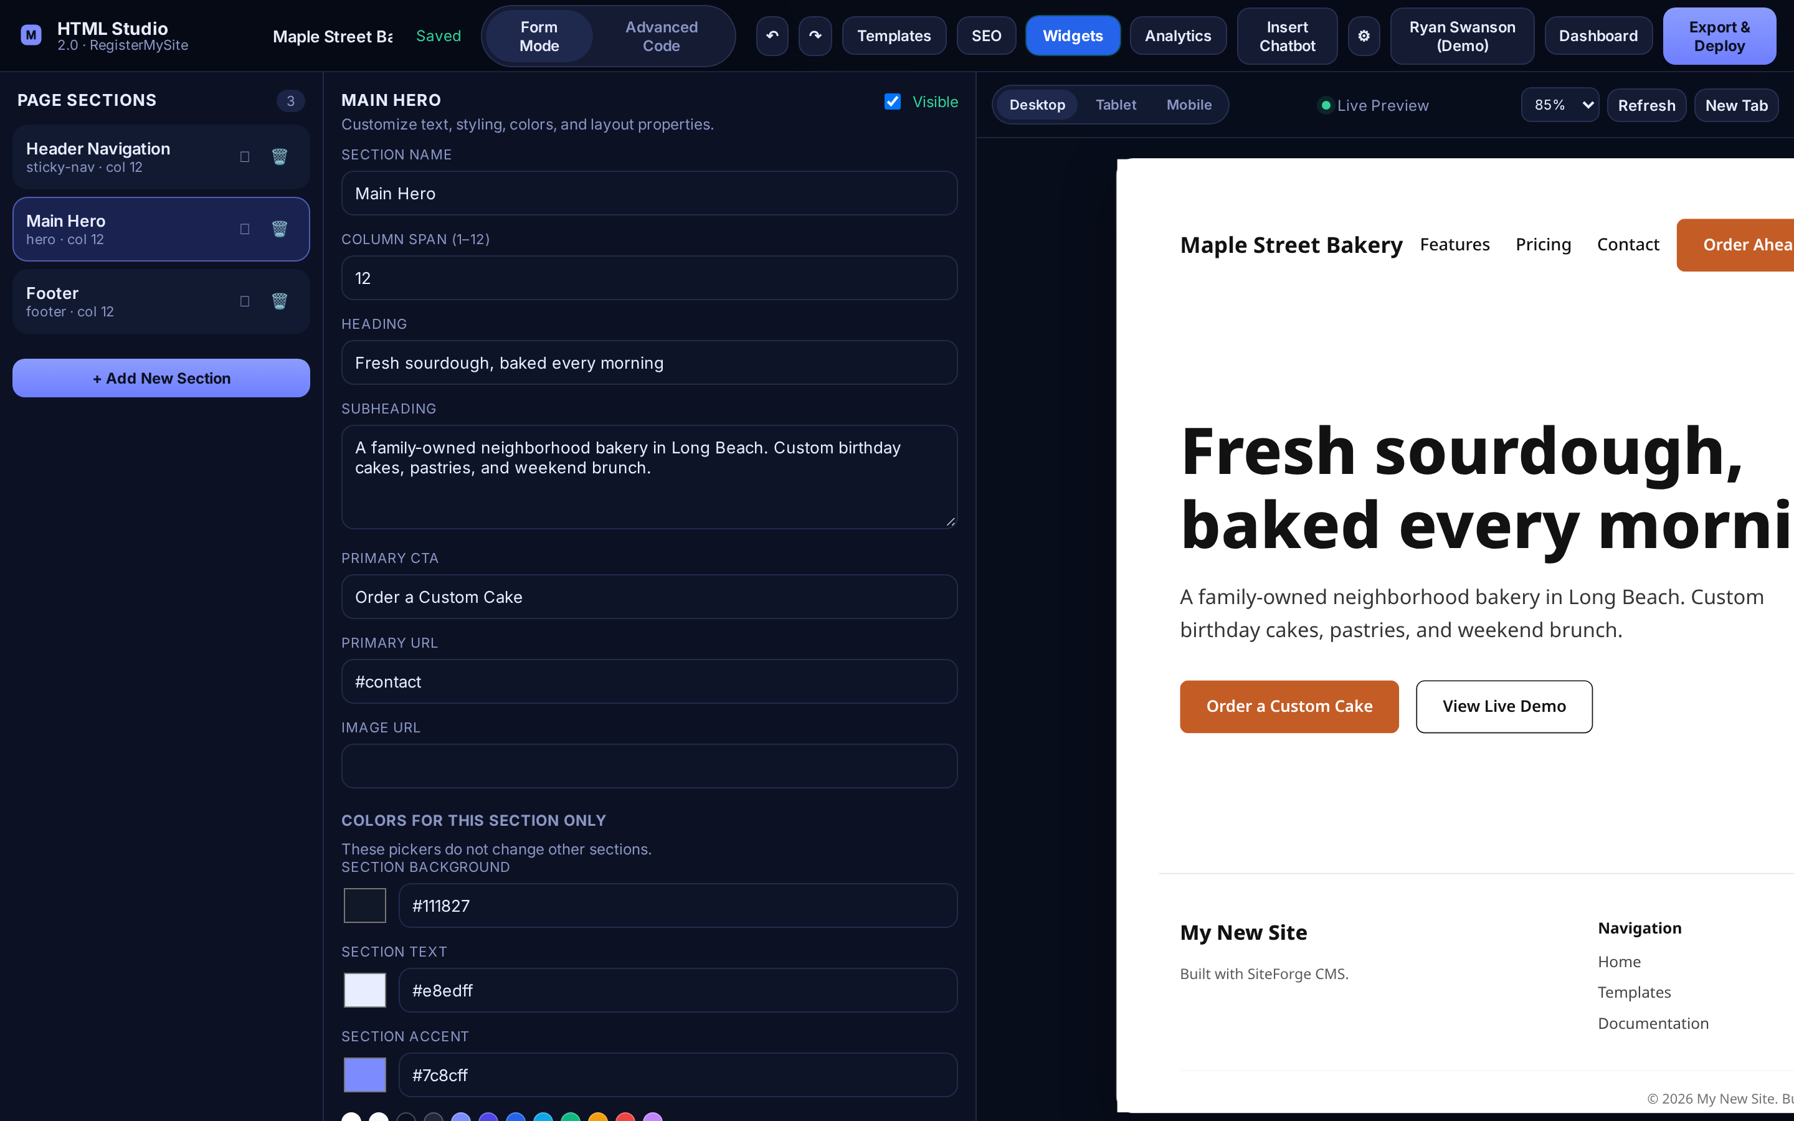
STEP 3 · MAKE IT YOURS
Edit a section with Form Mode
1
Click a section, like Main Hero
4
1
2
Change the Heading
2
3
3
Change the Subheading
4
Watch the Live Preview update
Scroll down for button text, links, image URL & colors.
Tip Stuck? Type a request in the AI copilot box and click “Apply AI edit.”
Editing the hero headline for Maple Street Bakery.
registermysite.com
7
Notes:
Step three: make it yours. This is where you'll spend most of your time.
Click a section on the left, number one. Here I clicked Main Hero, the big section at the top of the page.
The middle panel fills with fields. Number two is the Heading; I typed "Fresh sourdough, baked every morning." Number three is the Subheading, the sentence underneath.
And number four, the preview on the right updates right away.
If you scroll down in the middle panel you'll find the button text, where the button links to, the image link, and colors for that section.
Also, at the bottom there's the AI copilot. You can type something like "make this sound warmer" and click Apply AI edit.
I did the same for the Header Navigation, putting in the bakery name and an "Order Ahead" button.

Slide 8
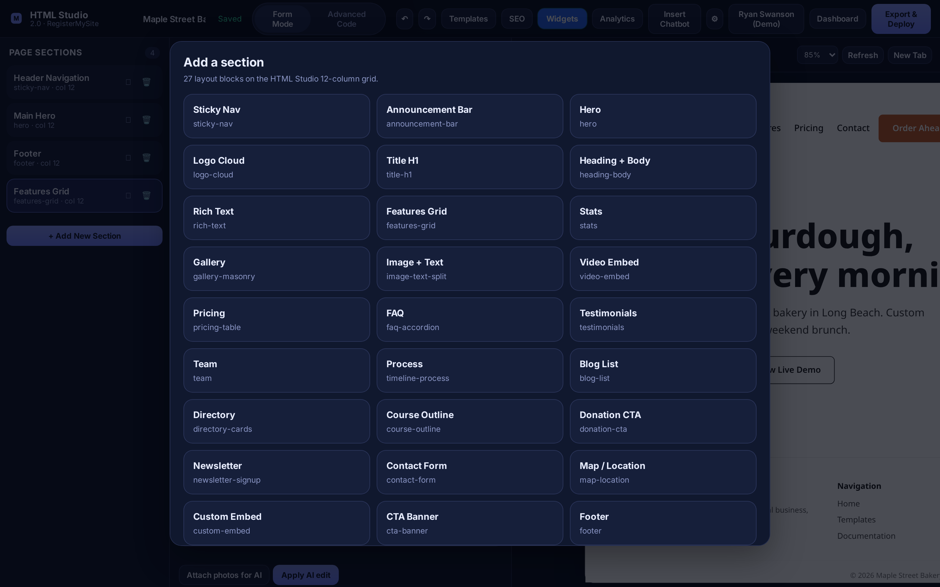
STEP 3 · MAKE IT YOURS
Add new sections
1
Click + Add New Section
2
2
Pick a block: Hero, Gallery, FAQ, Testimonials, Map, Contact Form, and more
1
3
Drag the new section into place in Page Sections
Tip New sections land at the very bottom, under the footer. Drag them up, then click Refresh if the preview lags.
The “Add a section” window. We used a Rich Text block for the bakery’s specialties & hours.
registermysite.com
8
Notes:
Want more on your page? Click + Add New Section at the bottom of the left panel, number one.
A window opens, number two, with all the building blocks: a hero, a gallery, pricing, an FAQ, testimonials, a map, a contact form, and lots more.
For the bakery, I added a Rich Text block and used it for three specialty cards plus hours and location.
Here's the one thing to remember: new sections always get added at the very bottom, even below the footer. So after you add one, drag it up in the Page Sections list to where you want it. If the preview doesn't catch up right away, click Refresh above the preview.
Another heads-up: a few template pieces, like the navigation links and the "Built with SiteForge CMS" line in the footer, aren't editable in Form Mode. If that matters for your business, let us know and we'll tidy it up in Advanced Code.

Slide 9
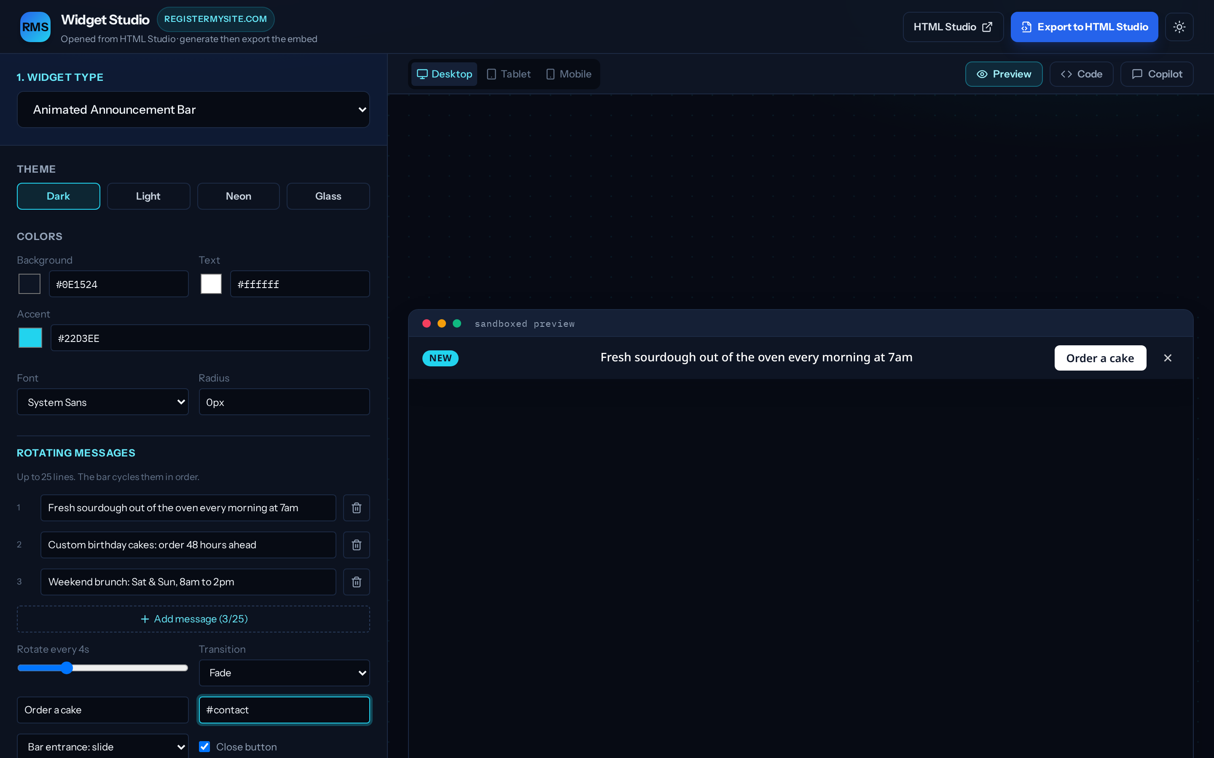
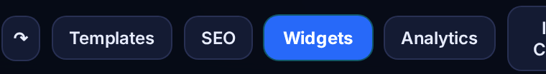
ADD-ON · WIDGETS
Open Widget Studio & choose a widget
1
In HTML Studio, click Widgets (opens Widget Studio)
2
2
Pick a Widget type. We used Animated Announcement Bar
3
3
Pick a Theme & colors
5
4
Type your Rotating messages
5
Check the Preview
4
Widget Studio (widget-studio.registermysite.com) opens in its own window.
registermysite.com
9
Notes:
Now for the fun stuff: add-ons. First up, Widgets.
Click Widgets in the top bar of HTML Studio. You can see it in the little picture at the bottom left. That opens Widget Studio in its own window.
Number two: choose the widget type. There are four: an Animated Announcement Bar, a Social Review Carousel, a Music or Media Player, and a Visitor Counter. For the bakery I picked the announcement bar, the thin strip across the top of the page.
Number three: pick a theme, Dark, Light, Neon, or Glass, and your colors.
Number four: type your rotating messages. I used "Fresh sourdough out of the oven every morning at 7am," "Custom birthday cakes: order 48 hours ahead," and "Weekend brunch: Sat and Sun, 8am to 2pm." You can have up to 25.
And number five, the preview on the right shows you exactly how it'll look.

Slide 10
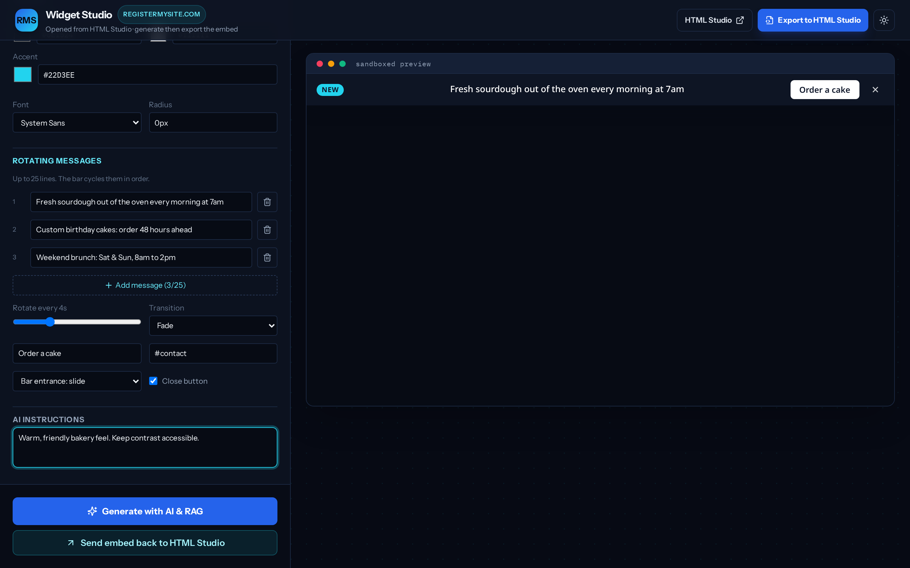
ADD-ON · WIDGETS
Set the button & generate
1
Set the button label & link (ours: “Order a cake” → #contact)
2
Optional: add AI instructions, e.g. “Warm, friendly bakery feel”
3
Click Generate with AI & RAG
4
Click Send embed back to HTML Studio
1
2
Important Change the default button! It starts as “Open HTML Studio →”, which isn’t what your customers want.
3
4
Same Widget Studio window, scrolled down.
registermysite.com
10
Notes:
Keep scrolling down in Widget Studio.
Number one: the button on the bar. Give it a label and a link. I used "Order a cake," linking to the contact part of the page. This one's important: the default button says "Open HTML Studio" and links to our tool, so always change it to something for your customers.
Number two is optional: AI instructions. I typed "Warm, friendly bakery feel. Keep contrast accessible."
Number three: click Generate with AI & RAG. It builds the widget for you in a few seconds.
Then number four: click Send embed back to HTML Studio. That drops the widget right into your page.

Slide 11
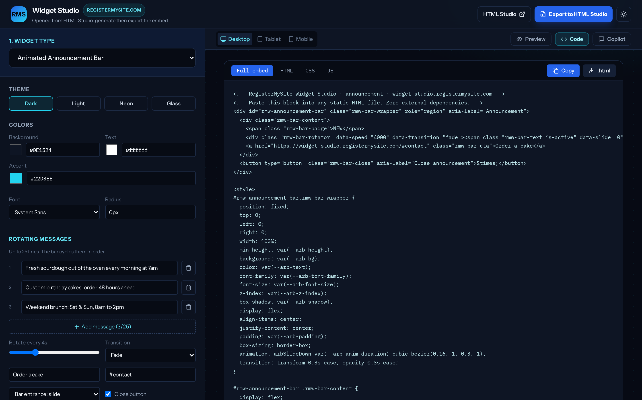
ADD-ON · WIDGETS
Grab the code, or export it straight in
1
The Code tab shows what was generated
4
2
1
2
Full embed = one block, no extra files
3
3
Copy or download .html to use it anywhere
4
Export to HTML Studio does it all for you
Tip For HTML Studio pages, just use Export. Copy is handy for other websites.
Widget Studio’s Code tab for our announcement bar.
registermysite.com
11
Notes:
Curious what it made? Click the Code tab, number one.
Number two, Full embed, is the whole widget in one self-contained block, with no extra files needed.
Number three: you can Copy it or download it as an .html file. That's handy if you want to put the same widget on a different website.
But for an HTML Studio page you don't need any of that. Number four, Export to HTML Studio, the button at the top, or the Send embed back button we saw on the last slide, does it for you.

Slide 12
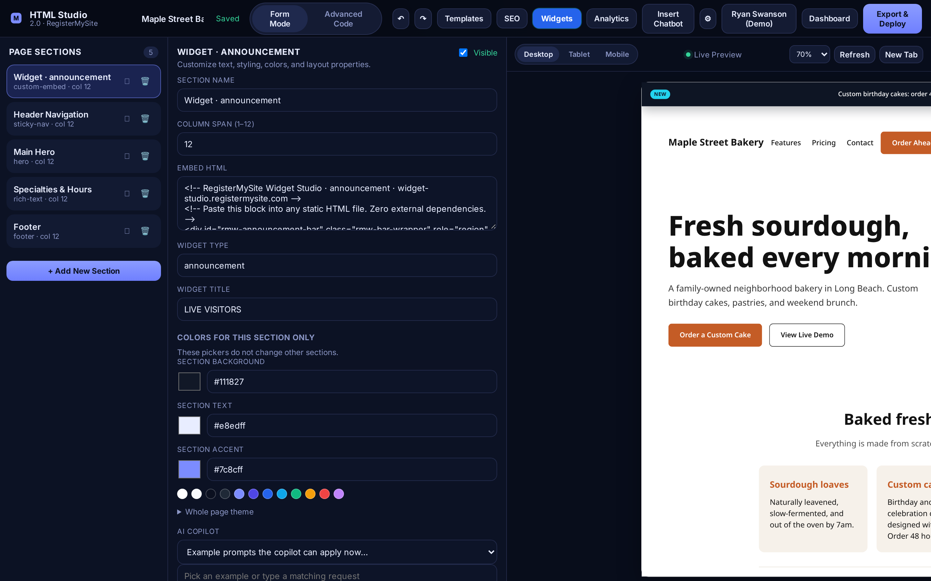
ADD-ON · WIDGETS
Move the widget to the top
1
A new Widget · announcement section appears. Drag it to the top of the list
1
2
2
The bar now sits across the top of your page
To change it later, edit the Embed HTML field, or run Widget Studio again.
Tip The section’s “Widget title” may say LIVE VISITORS. It’s just a label and doesn’t show on the page.
After dragging the widget section above the header.
registermysite.com
12
Notes:
Back in HTML Studio you'll see a new section called Widget, announcement. Like any new section, it lands at the bottom of the list, so, number one, drag it all the way to the top.
Number two: there it is, the announcement bar rotating across the top of the page with the "Order a cake" button.
If you want to change it later, you can edit the Embed HTML field, or just open Widgets again and send a new one.
Small heads-up: the section's Widget title field may say "LIVE VISITORS." That's only an internal label; your customers never see it.

Slide 13
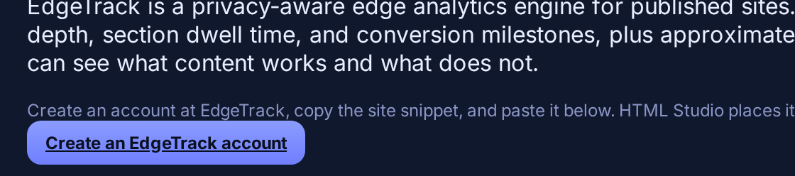
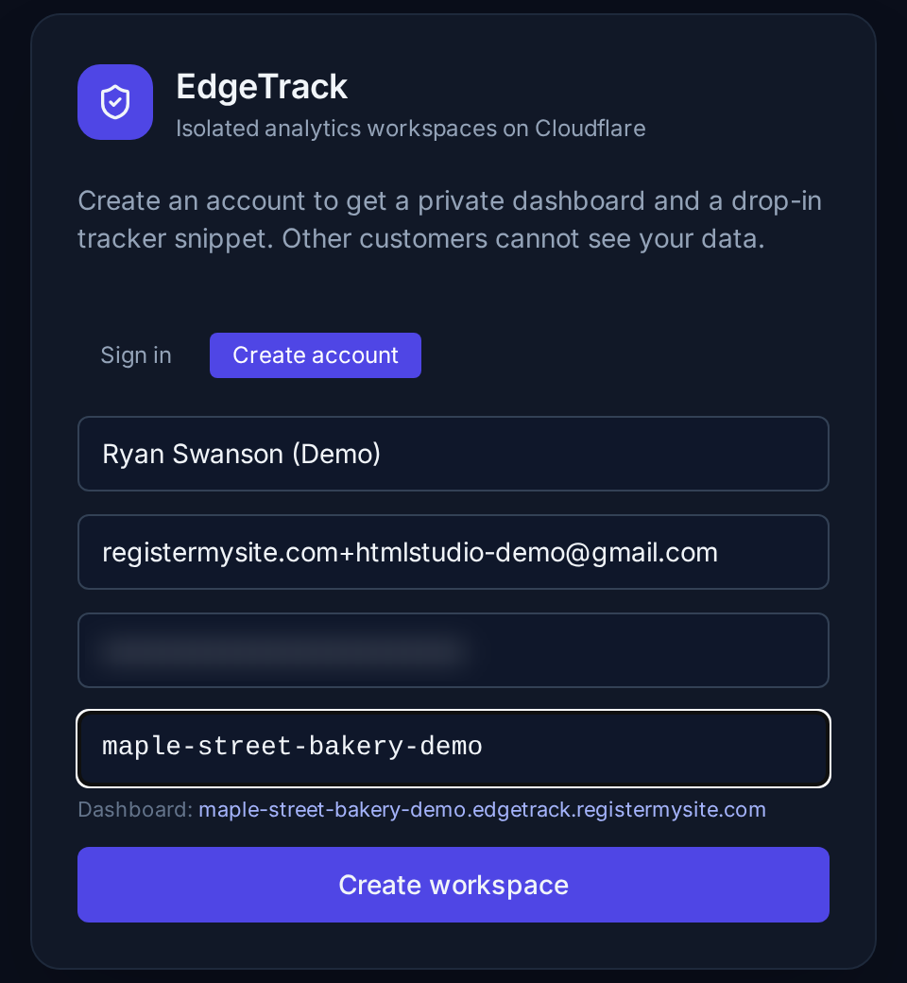
ADD-ON · EDGETRACK ANALYTICS
Create your EdgeTrack account
1
1
In HTML Studio click Analytics → Create an EdgeTrack account
2
2
Name, email & password (8+ characters)
3
4
3
A workspace slug: your private dashboard address
5
4
Click Create workspace
6
Left: HTML Studio’s Analytics window. Right: edgetrack.registermysite.com (password blurred).
registermysite.com
13
Notes:
Next add-on: EdgeTrack analytics. This is how you find out how many people visit your page, where they come from, and what they look at. It's privacy-friendly and doesn't need a cookie banner.
In HTML Studio click Analytics. A window opens called "EdgeTrack analytics." Click Create an EdgeTrack account, number one.
That takes you to EdgeTrack. Click Create account and fill in your name, email, and a password, numbers two through four.
Number five is your workspace slug. That becomes your private dashboard address. I used maple-street-bakery-demo, so my dashboard lives at maple-street-bakery-demo.edgetrack.registermysite.com.
Then number six, click Create workspace. Keep this tab open; we need one thing from it.

Slide 14
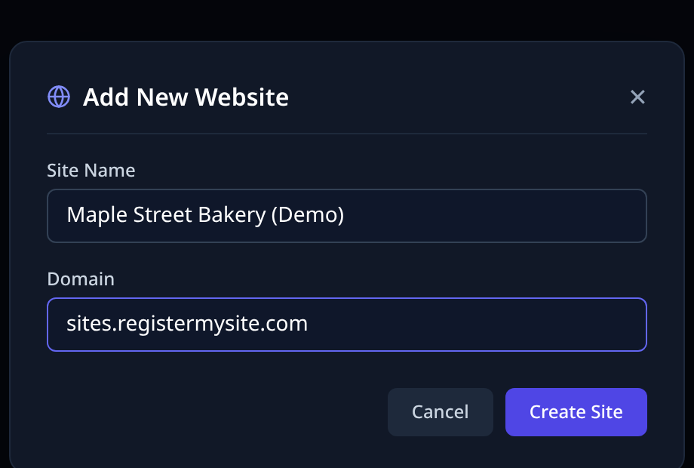
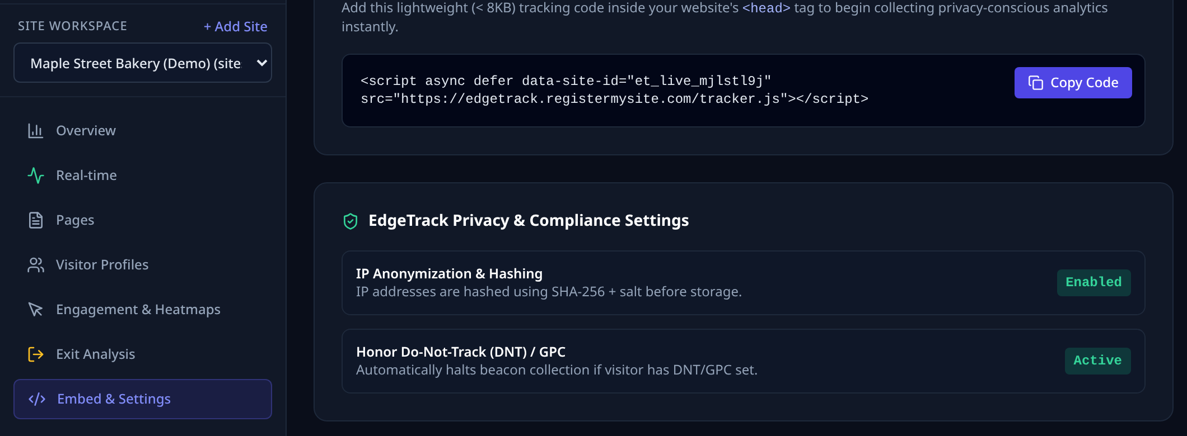
ADD-ON · EDGETRACK ANALYTICS
Add your site & copy the tracking code
1
6
2
3
5
4
1 Click + Add Site (top of the sidebar)
2 Site Name: ours is “Maple Street Bakery (Demo)”
3 Domain: where the page will live
4 Click Create Site
5 Open Embed & Settings
6 Click Copy Code. It’s one short line starting with <script
EdgeTrack dashboard: “Add New Website” (left) and “Embed Tracking Script” (right).
registermysite.com
14
Notes:
Once you're in EdgeTrack, click + Add Site in the left sidebar, number one.
Give it a name, number two. I used "Maple Street Bakery (Demo)." Number three is the domain where your page will live. Ours is going on sites.registermysite.com. Then click Create Site, number four.
Now click Embed & Settings in the sidebar, number five. You'll see "Embed Tracking Script" with one short line of code. Click Copy Code, number six.
That's the only thing we need from EdgeTrack. Back to HTML Studio.

Slide 15
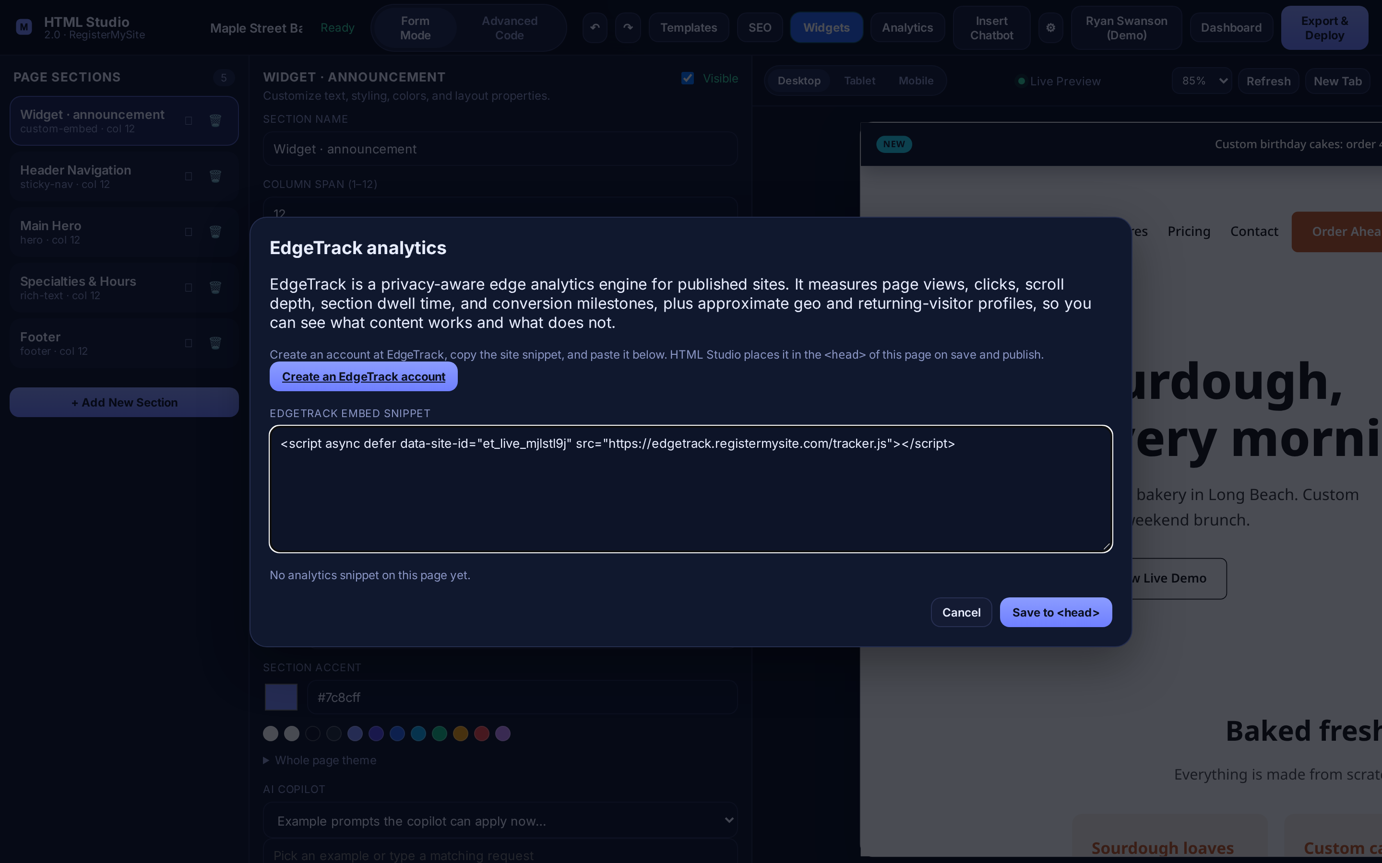

ADD-ON · EDGETRACK ANALYTICS
Paste it into HTML Studio
1
Click Analytics
1
2
Paste into EdgeTrack embed snippet
3
Click Save to <head>
2
You’ll see this confirmation:
3
Tip Visits start showing once the page is published.
HTML Studio’s “EdgeTrack analytics” window with our real snippet pasted in.
registermysite.com
15
Notes:
Back in HTML Studio, click Analytics again, number one.
Paste the code into the box called "EdgeTrack embed snippet," number two. Then click Save to head, number three.
You'll see a little confirmation at the bottom right: "EdgeTrack snippet added to page head." Done! Analytics is on.
Visitors start showing up in your EdgeTrack dashboard once the page is published, which we'll do in a few minutes.

Slide 16
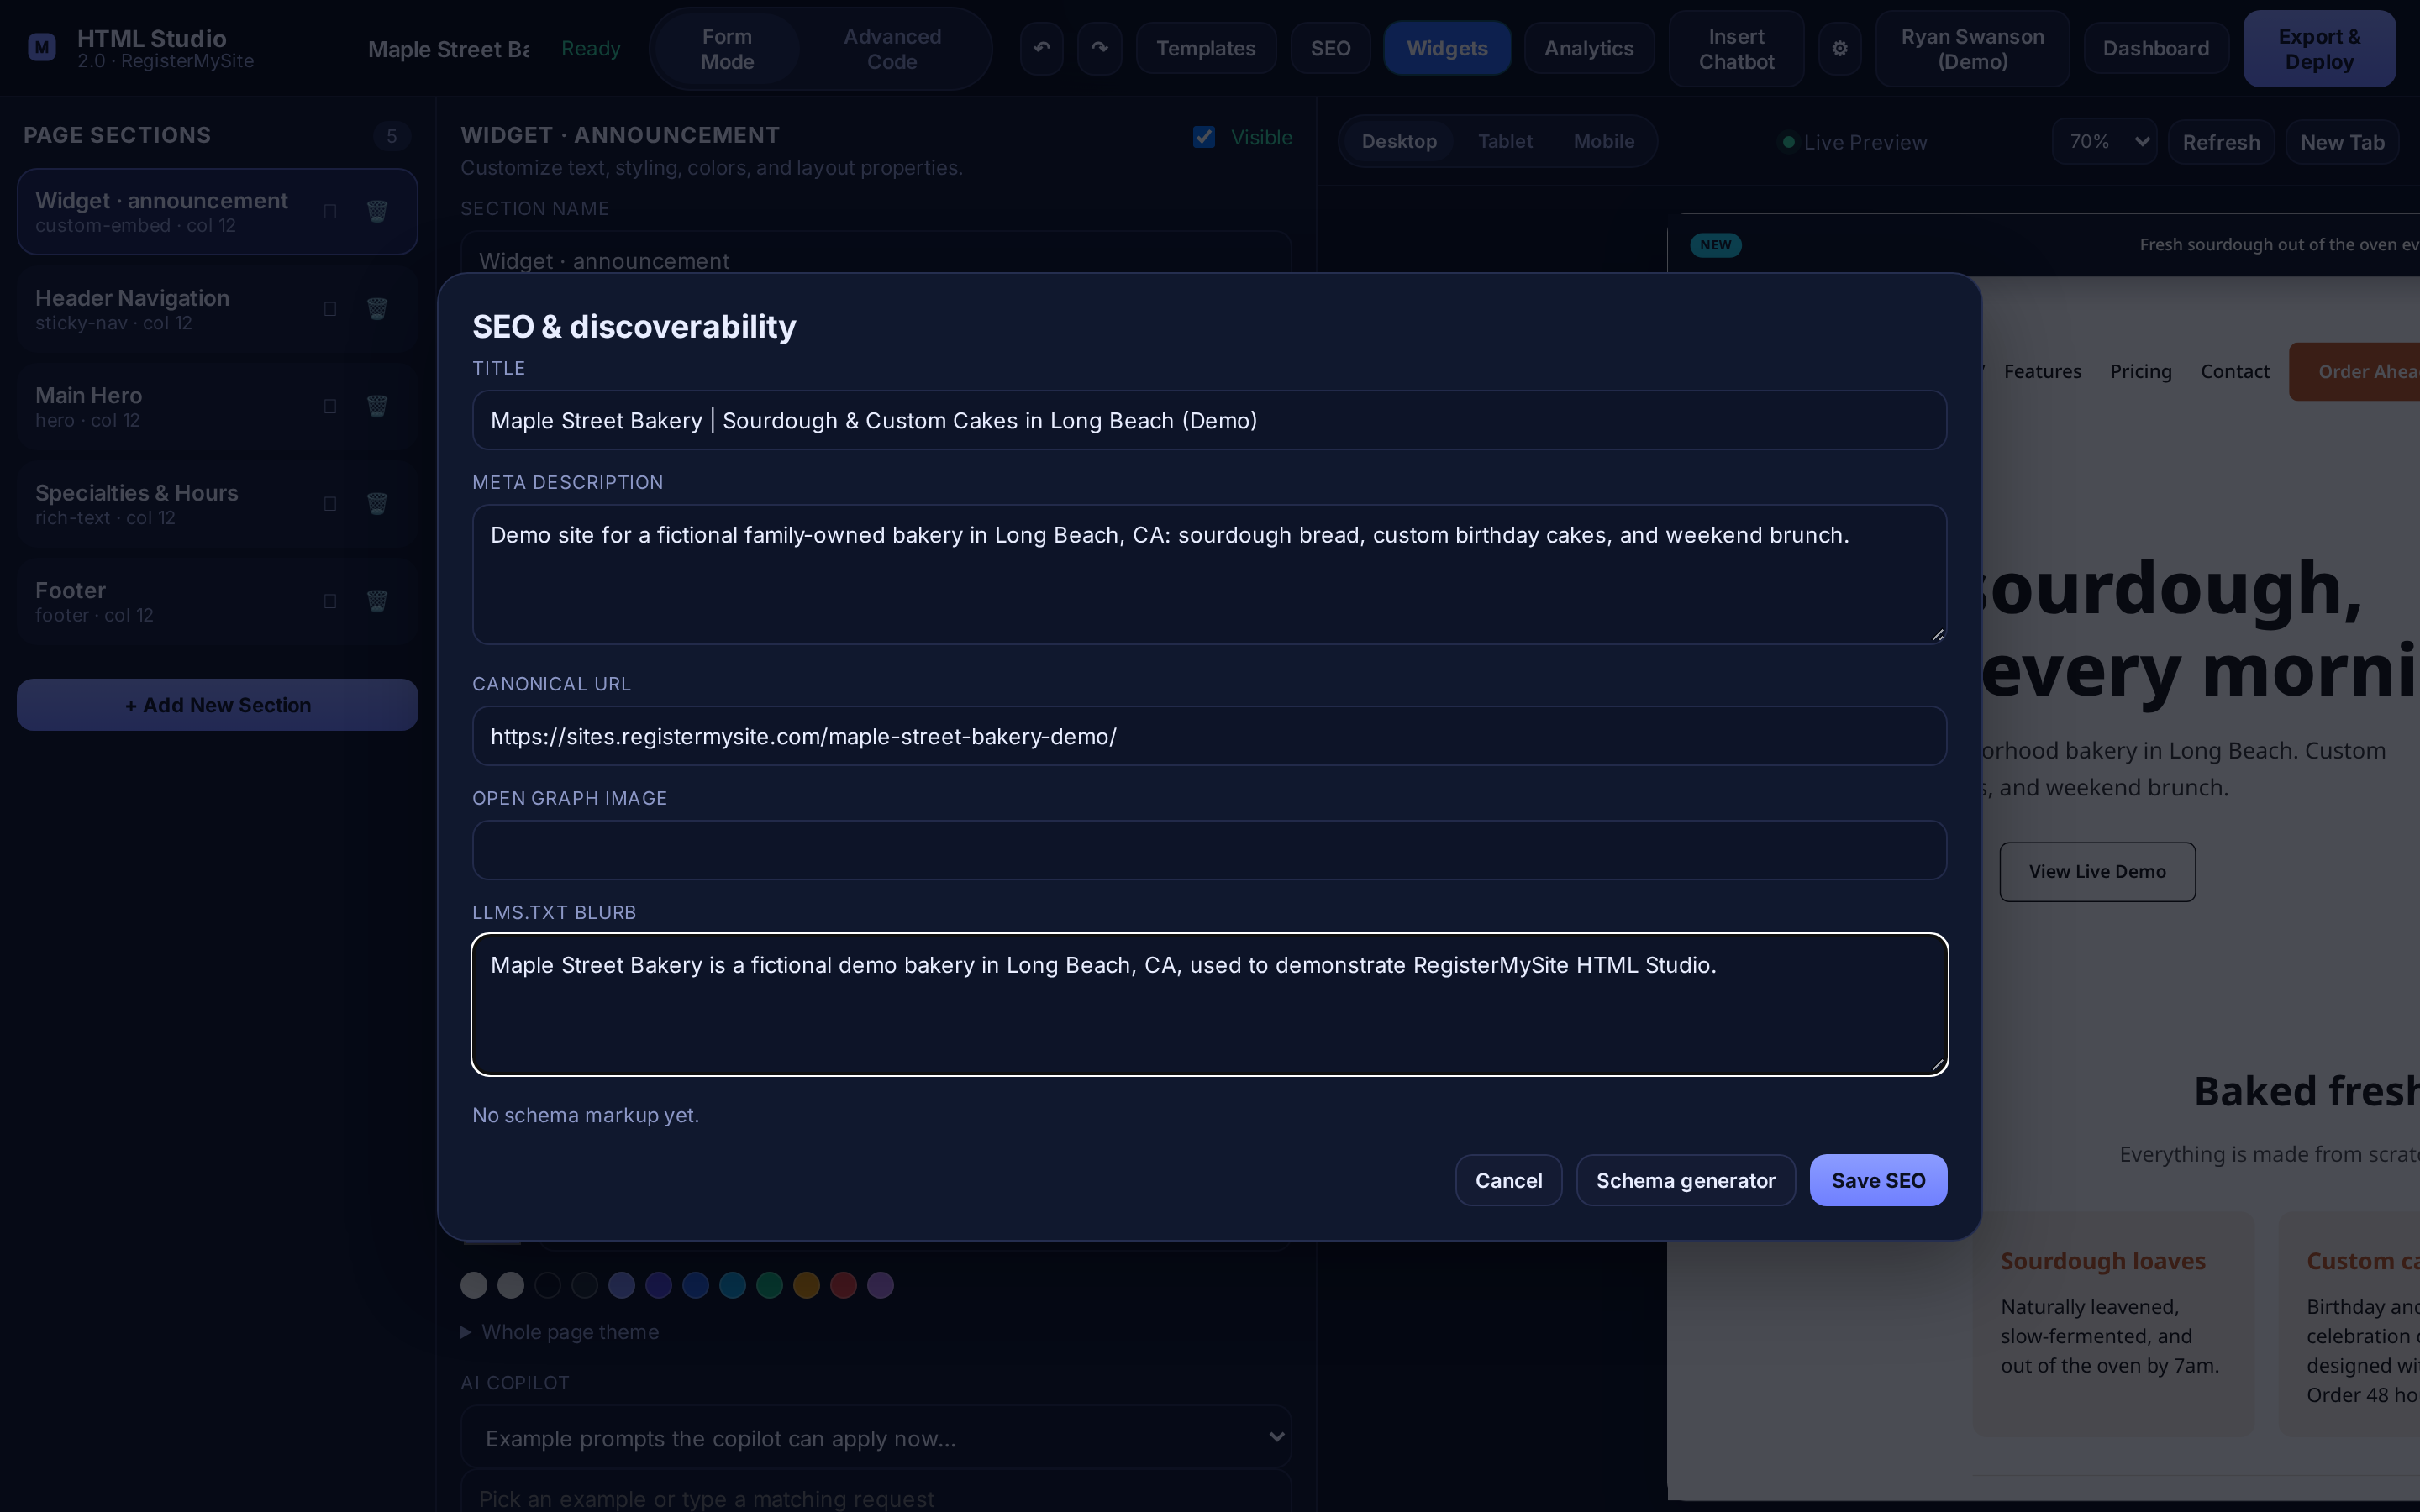
ADD-ON · SEO & SCHEMA
Fill in your SEO basics
1
Click SEO
1
2
Title: shows in Google & the browser tab
2
3
Meta description: the one-line summary under it
3
4
4
Canonical URL: your page’s live address
5
Click Save SEO
Tip Name + what you do + city makes a great title, e.g. “Maple Street Bakery | Sourdough & Custom Cakes in Long Beach.”
5
The “SEO & discoverability” window for the demo page.
registermysite.com
16
Notes:
Now let's help Google find you. Click SEO in the top bar, number one. The window is called "SEO and discoverability."
Number two, the Title. That's the blue link people see on Google and the name in the browser tab. A great formula: your business name, what you do, and your city.
Number three, the Meta description. That's the sentence or two under the link on Google. Make it sound inviting.
Number four, the Canonical URL. That's simply your page's live address. Ours is sites.registermysite.com/maple-street-bakery-demo/.
There's also an Open Graph image, the picture that shows when someone shares your link, and an llms.txt blurb, a short summary for AI assistants.
Then click Save SEO, number five. Next to it is the Schema generator; that's our next slide.

Slide 17
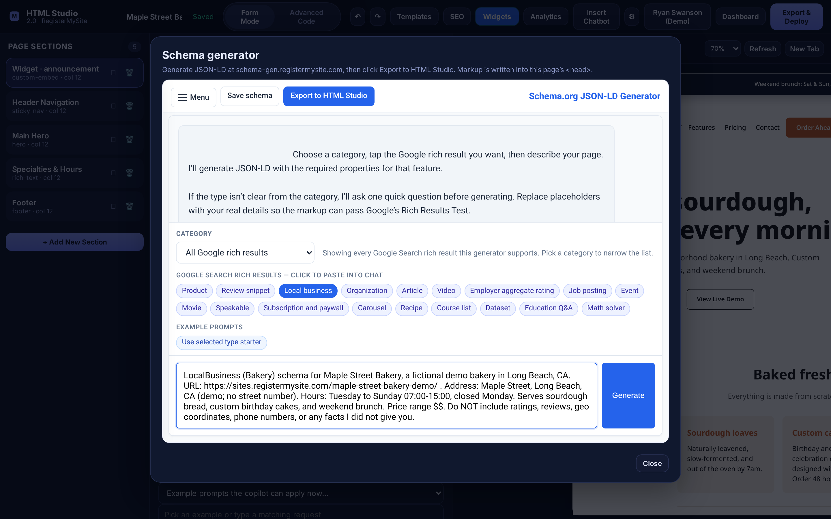
ADD-ON · SEO & SCHEMA
Generate schema markup for Google
1
In the SEO window, click Schema generator
2
Tap the rich result: Local business
3
Describe your business: name, address, hours, price range
2
4
Click Generate
3
4
Important Only include real facts. Say “don’t add ratings or reviews” so it doesn’t make any up.
The Schema generator (schema-gen.registermysite.com) opens inside HTML Studio.
registermysite.com
17
Notes:
Schema markup sounds technical, but here's the simple version: it's a hidden label on your page that tells Google, "This is a bakery, here's the address, here are the hours." It helps you show up better in local search.
In the SEO window, click Schema generator, number one. It opens right inside HTML Studio.
Number two: tap Local business in the list of Google rich results.
Number three: describe your business in the box. Include your name, your page address, your street and city, your hours, and your price range.
Then click Generate, number four.
Very important: only give it real facts, and tell it not to add ratings or reviews. In my testing it sometimes invented star ratings and map coordinates, and you never want fake info on your page. For a local shop, ask for the specific type too, like "Bakery."

Slide 18
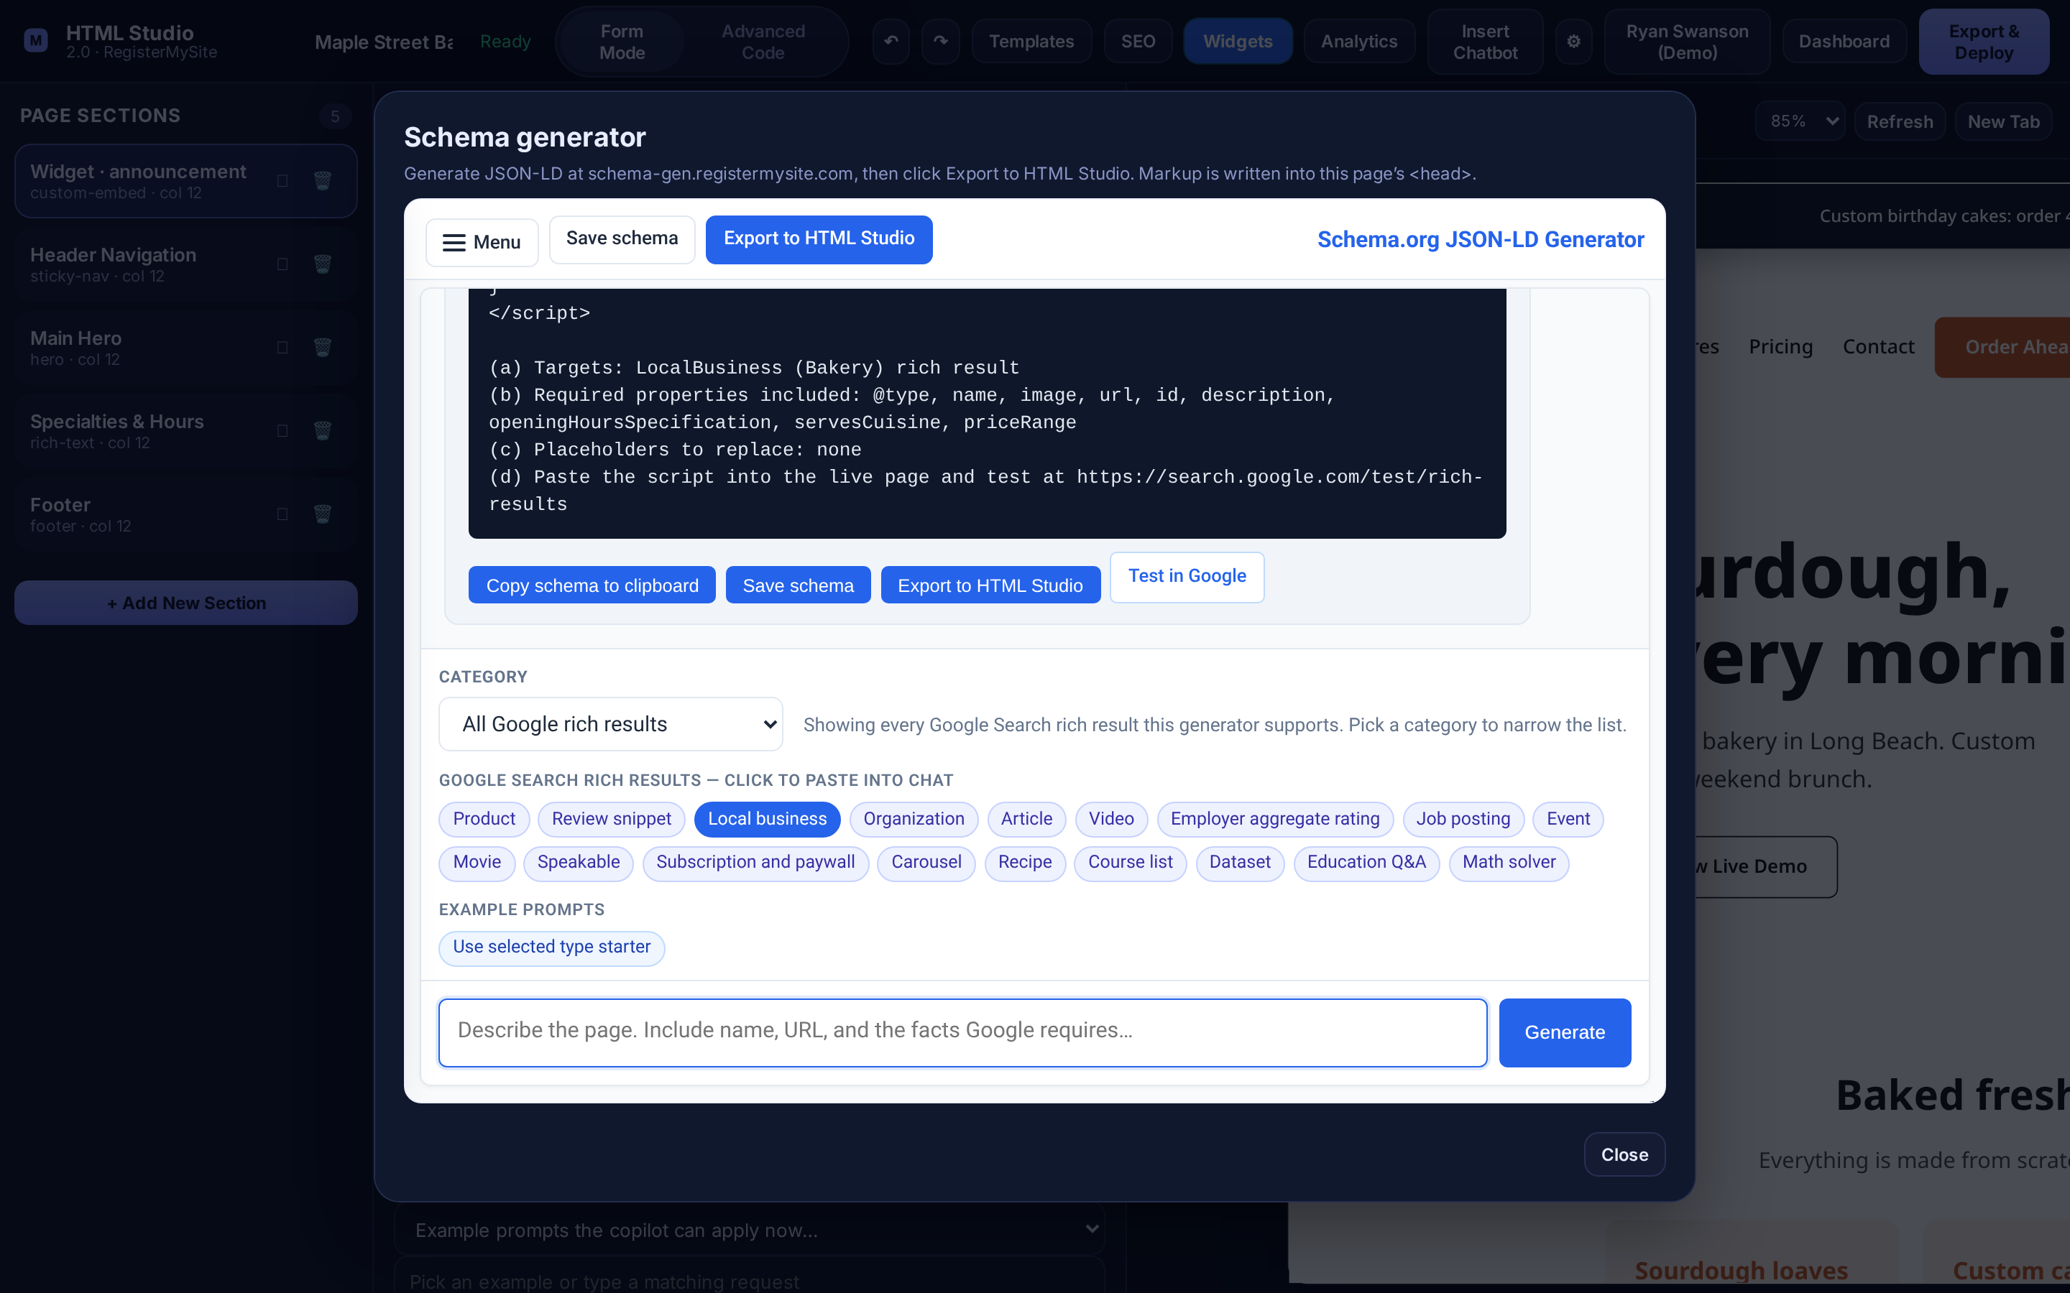
ADD-ON · SEO & SCHEMA
Check it, then export to your page
1
Read the summary; it lists any placeholders to replace
2
Click Export to HTML Studio
1
3
After publishing, use Test in Google
3
2
Back in SEO, the status line changes to:
Our real result: a “Bakery” schema with hours, price range & cuisine (code scrolled up).
registermysite.com
18
Notes:
The generator writes the code and a short summary underneath, number one. Read that summary. It tells you what the markup covers and whether there are any placeholders you need to fill in. Ours said "Placeholders to replace: none."
Then click Export to HTML Studio, number two. The window closes and the markup is attached to your page. If you open SEO again, the line at the bottom now reads "JSON-LD schema is attached to this page."
Number three: once your page is published, click Test in Google. That runs Google's Rich Results Test so you can see if Google likes it.
Presenter note: my first attempt came back as a generic LocalBusiness with a couple of made-up details, so I asked again, more specifically, and got a clean Bakery result. It's fine to regenerate until it's right. It still left out the street address, so for a real client, double-check the address is in there before you export.

Slide 19
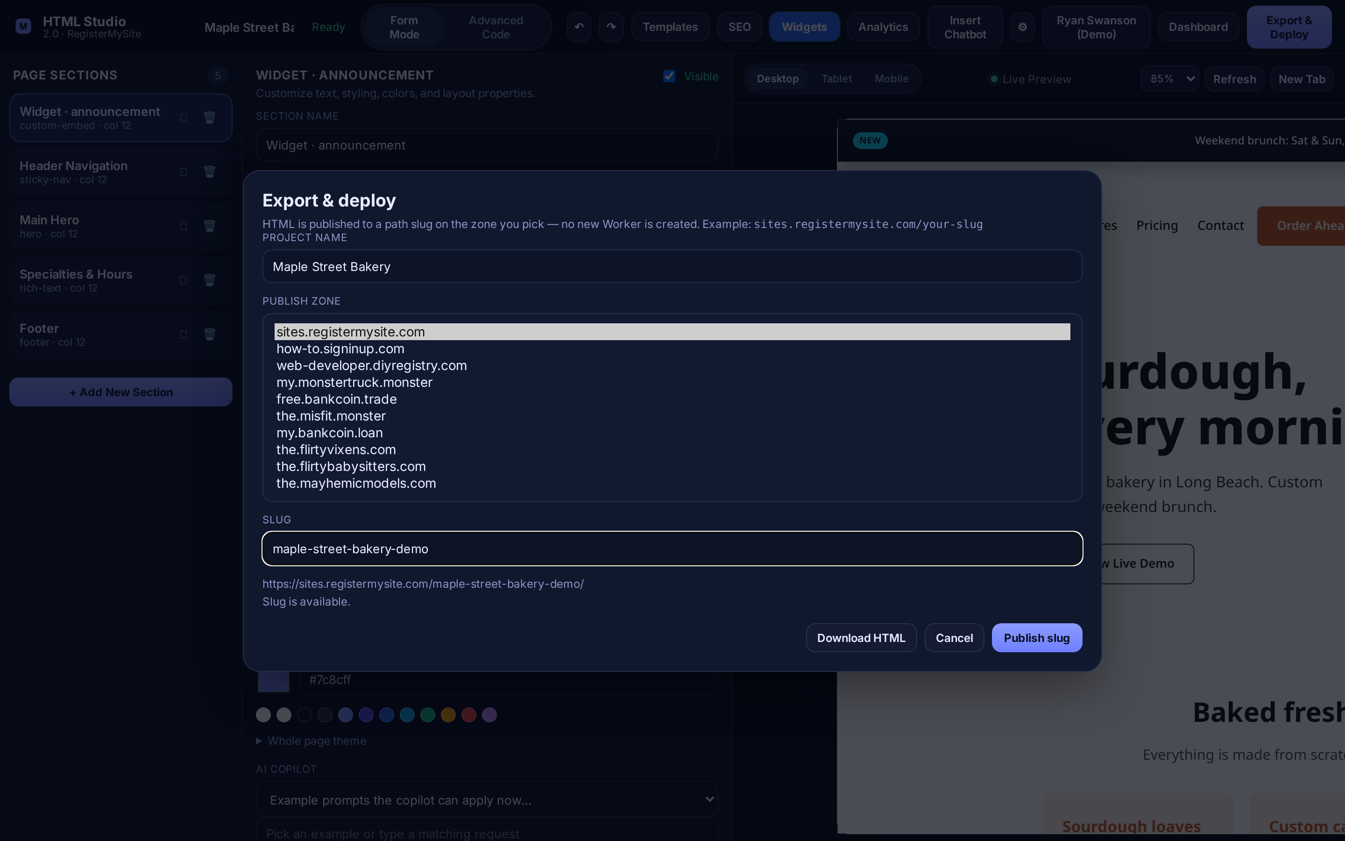
STEP 4 · GO LIVE
Open Export & Deploy, pick your domain
1
Click Export & Deploy
1
2
Give it a Project name
2
3
Open Publish zone and pick a domain. We chose sites.registermysite.com
3
Tip Stick with sites.registermysite.com for a business page unless we’ve set up a different domain for you.
The Publish zone drop-down, shown expanded (the list you see when you click it).
registermysite.com
19
Notes:
Step four: go live!
Click Export & Deploy in the top-right corner, number one. The "Export and deploy" window opens. It explains that your page will be published to a short name, called a slug, on the domain you pick.
Number two: give your project a name. I typed Maple Street Bakery.
Number three: click the Publish zone drop-down. This is the list of domains you can publish on. For a business page, choose sites.registermysite.com, highlighted in green. It's clean and professional.
Presenter note: the list also includes some other domains that aren't a good fit for a business page, so steer clients to sites.registermysite.com.

Slide 20
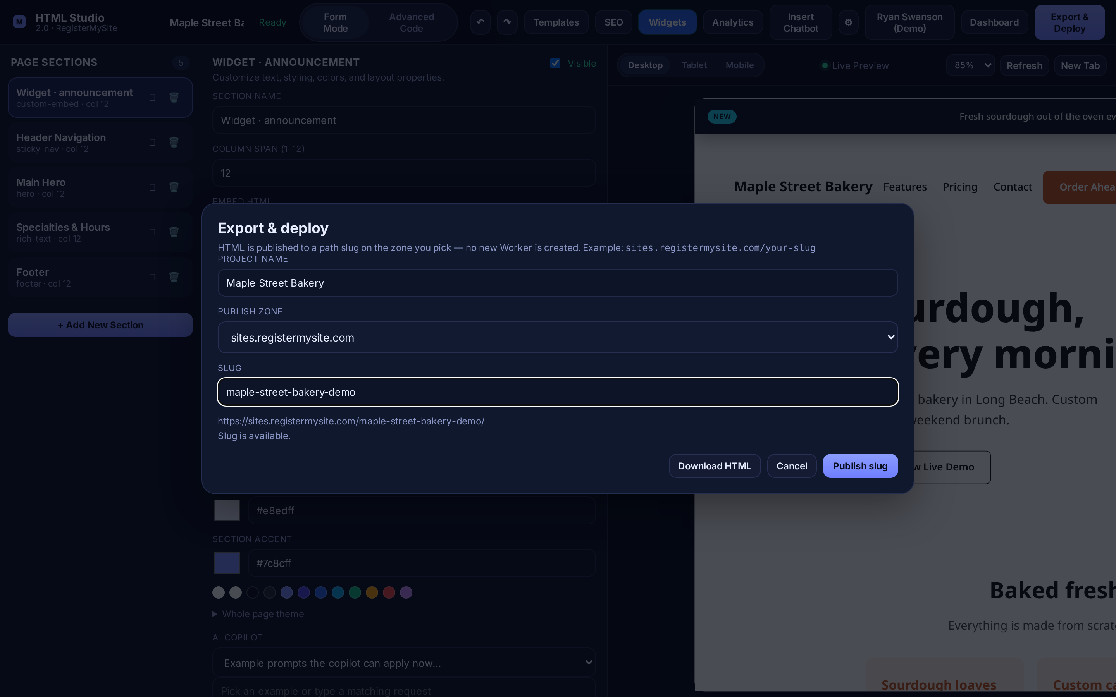
STEP 4 · GO LIVE
Choose your slug & publish
1
Type a short Slug: lowercase words with dashes
2
Check the address & “Slug is available.”
3
Click Publish slug
1
Seconds later you’ll see:
2
3
Your live page opens in a new tab. Made a change? Publish the same slug again to update it.
Our real publish: sites.registermysite.com/maple-street-bakery-demo/
registermysite.com
20
Notes:
Number one: type your slug. That's the last part of your web address, so keep it short, lowercase, with dashes between words. I used maple-street-bakery-demo.
Number two: right below, it shows the full address, and a line telling you whether the slug is available. Green light: "Slug is available." If someone else has it, it'll say it's taken, so just try another.
Number three: click Publish slug.
A few seconds later you'll see "Live at" and your address, and your page opens in a new tab.
Made a change later? Just come back and publish the same slug again. It'll say "You own this slug, publish will update it." You can see and manage everything you've published under the gear button, Published sites.

Slide 21
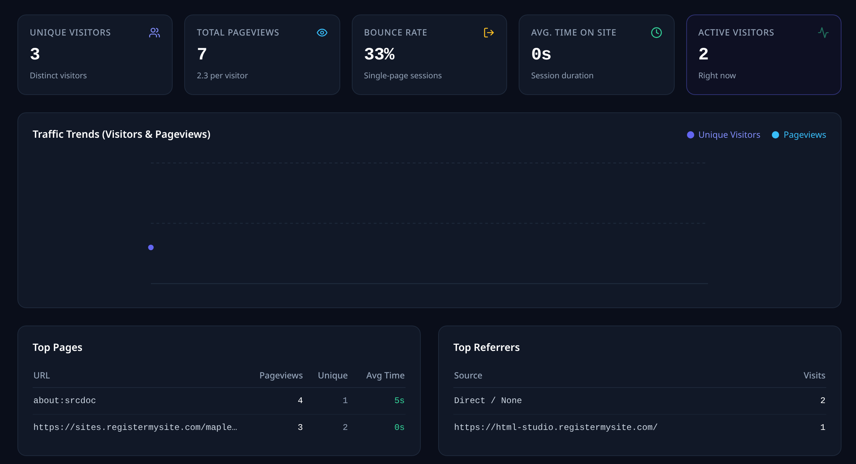
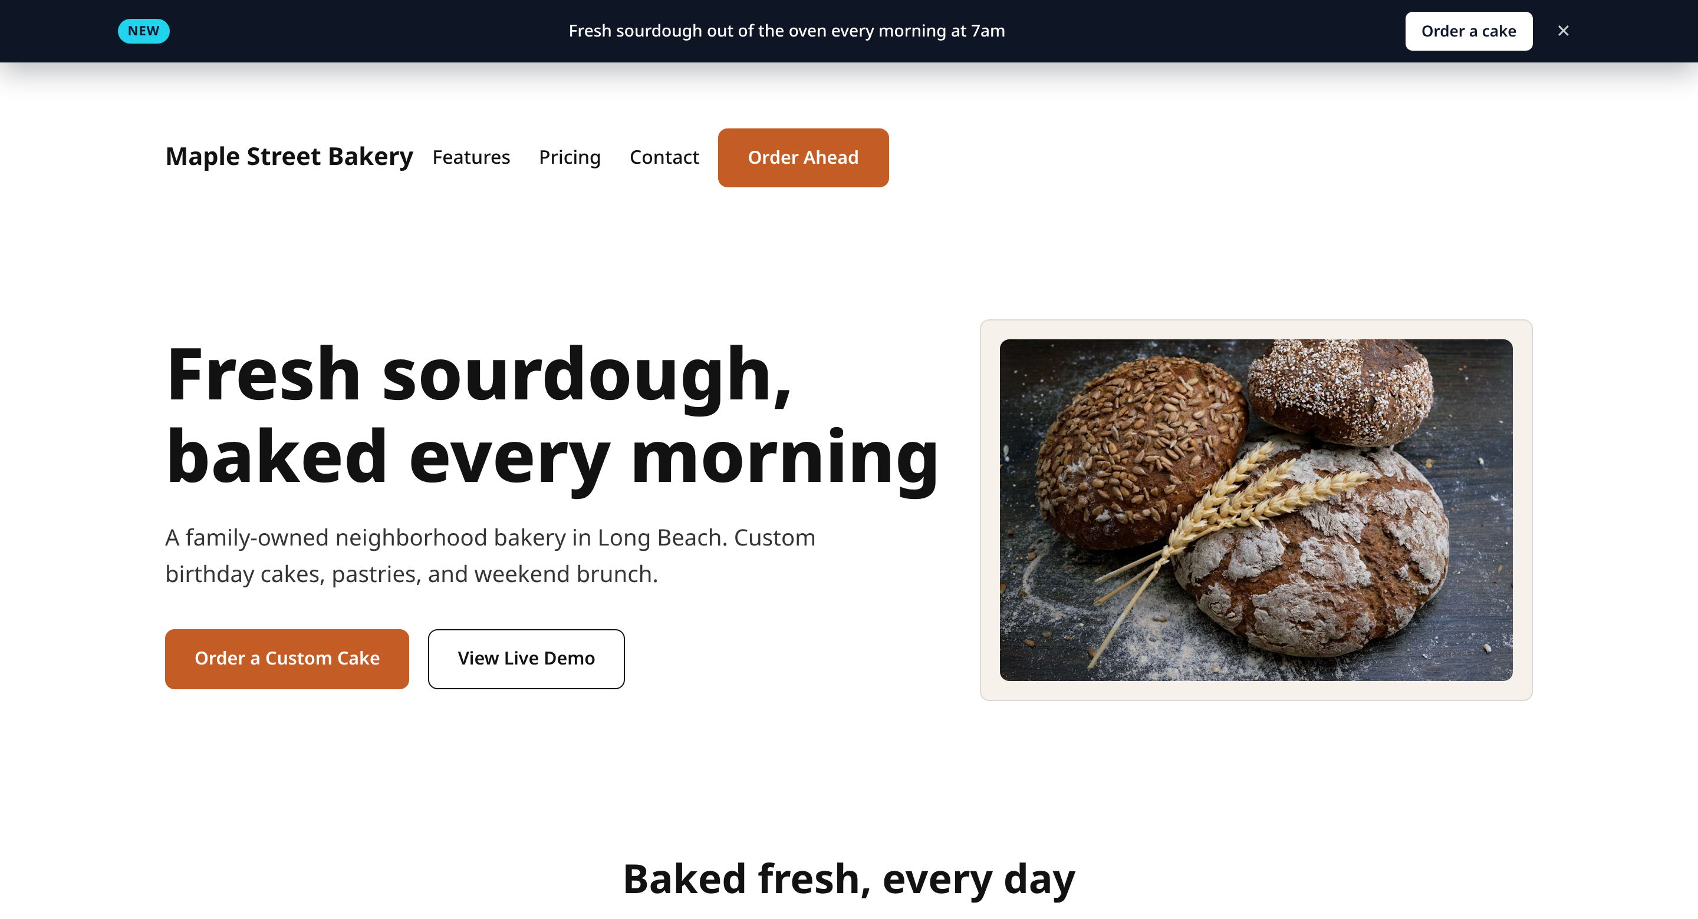

YOU’RE LIVE!
The finished page, on the web
2
1
https://sites.registermysite.com/maple-street-bakery-demo/
Announcement bar widget
EdgeTrack counting visits
Bakery schema in the page
SEO title & description
Live page (left) and the EdgeTrack Overview a few minutes after publishing (right).
registermysite.com
21
Notes:
And here it is: our Maple Street Bakery page, live at sites.registermysite.com/maple-street-bakery-demo.
Number one, the announcement bar widget rotating across the top with the Order a cake button. Then the header, the hero with our bread photo, the specialties, and the hours.
Number two, on the right, is the EdgeTrack dashboard a few minutes after publishing. It's already counting visitors and pageviews.
And behind the scenes, the Bakery schema and our SEO title and description are in the page, ready for Google.
Presenter note: EdgeTrack also counts your own visits while you're editing in HTML Studio (they show up as "about:srcdoc"), so don't be surprised by a few extra pageviews at first.
That's the whole flow, start to finish.

Slide 22






RECAP
Your HTML Studio checklist
1
2
3
Create account
Template & sections
Widgets
Sign in → Create account
Templates, then edit in Form Mode
Widget Studio → Send embed back
4
5
6
EdgeTrack
SEO & Schema
Publish
Copy Code → Save to <head>
Save SEO → Export to HTML Studio
Pick a zone & slug → Publish slug
registermysite.com
22
Notes:
Let's recap the whole thing in six steps.
One: create your account. Sign in, then Create account.
Two: pick a template and edit your sections in Form Mode, and remember to drag new sections into place.
Three: Widgets. Build it in Widget Studio and send it back to HTML Studio.
Four: EdgeTrack. Create your workspace, add your site, copy the code, and Save to head.
Five: SEO and Schema. Fill in your title and description, generate your schema with real facts only, and export it.
Six: publish. Pick sites.registermysite.com, choose your slug, and click Publish slug.

Slide 23



YOUR NEXT STEP
Let’s build your page.
html-studio.registermysite.com
Want us to build it with you? registermysite.com
(562) 751-4597
info@registermysite.com
In person across LA & Orange County
registermysite.com
23
Notes:
That's it! Your next step: go to html-studio.registermysite.com, create your account, and start with a template tonight.
And you don't have to do it alone. If you'd like us to build it with you, or connect it to your own domain name, call or text us at (562) 751-4597 or email info@registermysite.com. We meet with businesses in person across LA and Orange County, and remotely everywhere else.
Thanks so much for your time. What questions do you have?

